Slide 1


Lecture 4+5: Models, Data, and Statistical Inference using R
Noel Cadigan
CFER
Centre for Fisheries Ecosystems Research

Slide 2
F6004 Lecture 4 Outline
Models and data (parts of Haddon, chapter 3)
Bringing models and data together, judging how well model predictions and the data “fit”
Complexity in models, adding parameters, reality vs. simplicity
Methods to judge how well models and data “fit”
Least squares approach – residual error
Non-linear estimation, using R to find minimum sum of residual error
Numerical optimization and root finding.
Estimating uncertainty about the model
Methods based on parametric statistics, SD, SE, 95% CI, Variance…Normal distributions
Bootstrap

Slide 3
Fitting models with data
The models we have looked at so far (e.g. logistic, YPR) are simple mathematical representation of population dynamics
that nevertheless give some fundamental insights about the potential productivity of a fish stock
i.e. H_{MSY} or F_{MSY}, B_{MSY}, F_{MAX}

Slide 4
Parameters
These simple models involve some fundamental parameters (e.g. r, K) that determine the behaviour of the model – our model of stock dynamics.
We can simply assign plausible values to these parameters, and then examine the model output
But what is plausible – it is subjective

Slide 5
Fitting models with data
Remember that the clients of stock assessment prefer objective advice.
So we need an objective means to specify values for the model parameters (e.g. r, K).
However, the choice of model is in many cases somewhat subjective ……
Advanced stock assessment looks at model uncertainty as well. We will too in F6005.

Slide 6
Fitting models with data
Data can provide an objective means to estimate parameters.
If we have some data from surveys or elsewhere that are measurements of the state of the stock over some period of time
then we can find values of the model parameters that ensure that the model agrees as close as possible to the data

Slide 7
Fitting models with data
We will start with very simple models and parameter estimation methods
we will use these as “spring boards” to more complicate and practically relevant models
so hang on,

Slide 8
Fitting models with data: 3 requirements
A formal mathematical model of a system, which is capable of generating predictions about the observable world.
Data from the system to be used when estimating parameter values
A criterion (or objective function, or fit function) to judge the quality (or closeness) of the fit between model predictions and observed data.

Slide 9
Fitting models with data: 3 requirements
However, simply fitting the data well does not mean a model is good
The model must generate biologically sensible predictions, especially when predicting behaviour outside of the range of data (e.g. initial stock size, carrying capacity K, etc).
There are many models (e.g. high-order polynomials) that can fit data well but give silly predictions

Slide 10
3rd order polynomial example
model: index = θ_{o} + θ₁year + θ₂year^2 + θ₃year^3
fits the data well
predictions are not reasonable
not possible

Slide 11
Fitting models with data: 3 requirements
What is a biologically sensible model can be subjective
However, there is a general principal that simple is usually better
Principle of parsimony:

Slide 12
Principle of parsimony
From Wikipedia, the free encyclopedia
Occam's razor (or Ockham's razor)^{[1]} often expressed in Latin as the lex parsimoniae, translating to law of parsimony, law of economy or law of succinctness, is a principle that generally recommends, when faced with competing hypotheses that are equal in other respects, selecting the one that makes the fewest new assumptions.

Slide 13
Which comes first: the model or data
Conceptually, model selection is independent of the data
Once a model is chosen, optimum values for parameters are selected based on data
In practise, a range of plausible models are available, and model selection occurs in steps, based partly on the ability to fit data, but also on the reliability of the model

Slide 14
Quality of fit vs parsimony vs reality
More complicated models may seem more realistic because they are more flexible (see production curve example in Haddon, Fig. 3.1)
If a more flexible model does not fit the data any better than a more simple model, then there is a tendency to go with the more simple model.
More complicated models are harder to estimate, and require more data – is the cost worth it??

Slide 15
Quality of fit vs parsimony vs reality
More complicated models usually fit the data better, but other predictions may not be better.
There are ways to assess model prediction error – i.e. cross validation, Akaike’s Information Criterion (AIC) – described later
Highly parameterized models can have some insidious biases –especially related to variance parameters which are required to account for uncertainty in the data

Slide 16
Uncertainty
We have previously discussed survey indices of abundance that can be used to estimate stock assessment model parameters
These indices are not exactly measurements of stock size
They have sampling variability
You will estimate this variance in assignment 1

Slide 17
Uncertainty
This sampling uncertainty (sometimes called measurement error) is one reason why our models will not fit our data exactly
The other main reason is model process error – the model is only a simplification of population dynamics; that is, M is oprobably not constant, r is probably not constant, etc.
We cannot expect perfect fits

Slide 18
Uncertainty
Sometimes different values for parameters produce approximately the same fit to the data.
i.e. there are no well defined optimal values
and a range of values are consistent with our data
this tends to be a problem with more complicated models
referred to as parameter correlation

Slide 19
Uncertainty
Accounting for these uncertainties is a vital part of population modelling and stock assessment
We need to be able to characterize our uncertainty
i.e. provide a range of parameter values that are plausible
i.e. what is the range of realities that could produce our data
This should be an objective of stock assessment, and not just to provide a single set of stock size estimates

Slide 20
Uncertainty
First we focus on parameter estimation
then we consider how to quantify uncertainty.

Slide 21
Least square parameter estimation
The most commonly used estimation fit function.
It involves minimizing the differences between data and model predictions
Let O denote the observed value of some characteristic of a population, and let P denote a model predicted value of this characteristic.
For example, the characteristic could be total stock size, and P could be the discrete logistic model prediction and O could be a survey estimate.

Slide 22
Models and data
Another example is the relationship between the weight of a fish and its length.
A linear model of weight vs. length could [not should] be used, W = θ_{o}+ θ₁xL, and the parameters θ_{o} and θ₁ could be estimated based on length and weight measurements from a sample of fish.
I will try and use Greek symbols to denote parameters to estimate, to avoid confusion with variables that represent data or population characteristics

Slide 23
Models and data
another example is the logistic model of the proportion p of the stock mature at age a,
Note that p(a) is bounded between 0 and 1.
This model could be estimated based on samples of fish – and counts of how many were mature and immature, and what their ages were.

Slide 24
Least square estimation
Models are almost never perfect
They predict nature with error
Plus there is error in data
We usually denote error terms using ε
The basic estimation framework is O = P + ε.
ε is the residual error term between the model predicted values (aka fitted or expected) and data.

Slide 25
Least square estimation
Residual errors (ε’s) can be positive or negative.
We wish to estimate model parameters to make the errors as small as possible.
Say we have observations O₁,…, O_{n}, and a model that produces predictions P₁,…,P_{n}.
The least squares approach is to choose parameter values that minimize SSR=Σ_{i}(O_{i}-P_{i})² based on a set of data
n is the sample size

Slide 26
Least square estimation
SSR = Σ_{i}ε_{i} ² is the sum of squared residuals,
ε_{i} = O_{i} - P_{i}.
For parameter estimation, we are not really concerned if residuals are positive or negative, just that they be as small as possible in absolute value
This is why we square the residuals
But there are many other fit functions (SSR*=Σ_{i}|O_{i}-P_{i}| ) ……

Slide 27
Least square estimation
Least squares estimation minimized the overall distance between data and model predictions
observed, O
predicted, P
residual error, ε

Slide 28
The length-weight data
18 data points
print(tdata,digits=4)
$length
[1] 22 26 30 34 38 42 46 50 54 58 62 66 70 74 78 82 86 90
$weight
[1] 48.01 50.94 83.51 70.98 85.21 81.90 80.87 115.83 118.94 121.65
[11] 130.17 144.51 124.78 168.76 186.87 166.13 182.15 187.93
The model W = θ_{o}+ θ₁*L + ε

Slide 30
SSR surface

Slide 31
How to minimize the fit function
There are many ways to minimize the fit function, G(θ). Here θ represents all the parameters.
The conceptually simplest method is to do a grid search over the range of parameter values.
This is not numerically efficient
There are a variety of numerical methods
Many involve finding the root of the first derivative of the fit function

Slide 32
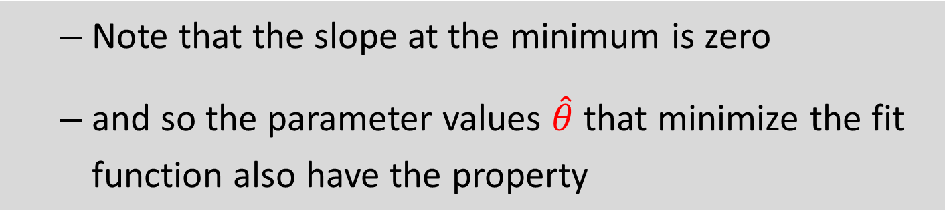
How to minimize the fit function
Note that the slope at the minimum is zero
and so the parameter values $\hat{θ}$ that minimize the fit function also have the property
For the linear model, the solution to the least squares estimates of θ is known

Slide 33
Least squares estimates for the linear model
The generic linear model is Y = θ_{o}+ θ₁*X + ε
The least squares estimators of both θ parameters, for a random sample of n data pairs (X₁,Y₁),…,(X_{n},Y_{n}), are
these are sample means
the ^ mean an estimate of…
this is a statistic, calculated from data

Slide 34
How to minimize the fit function
In R it is really easy to get least squares estimates for linear models,
data.fit = lsfit(X,Y) returns an object with many elements, but data.fit$coef will give the parameter estimates
For the length-weight data
This is only for linear models
> data.fit = lsfit(L,W)
> print(data.fit$coef)
Intercept X
2.201257 2.092769
>
> names(data.fit)
[1] "coefficients" "residuals" "intercept" "qr"
SSR = 2.123

Slide 35
SSR surface

Slide 36
How to minimize the fit function
For nonlinear models you have to do more work.
You have to write a function for the model and estimation, either as a single function or two functions
For the length-weight data
The only argument for the function are the parameters (parm), everything else (i.e. L,W) are global.
Do not re-assign these global values within the function
LW_SSR = function(parm){
Pred_W = parm[1] + parm[2]*L
SSR = sum((W - Pred_W)^2)
return(SSR)
}

Slide 37
How to minimize the fit function
R has several function minimizers.
optim is an R function that finds the minimum of a fit function
> parm.start = c(0,1)
> data.fit = optim(parm.start,LW_SSR)
> print(data.fit)
$par
[1] 2.214256 2.092548
$value
[1] 2123.409
$counts
function gradient
83 NA
$convergence
[1] 0
$message
NULL
And a fit function
need to give optim starting values for the parameters
optim returns the estimates, which are sort of close to the exact lsfit results
lsfit results
Intercept X
2.201257 2.092769
0 indicates successful completion

Slide 38
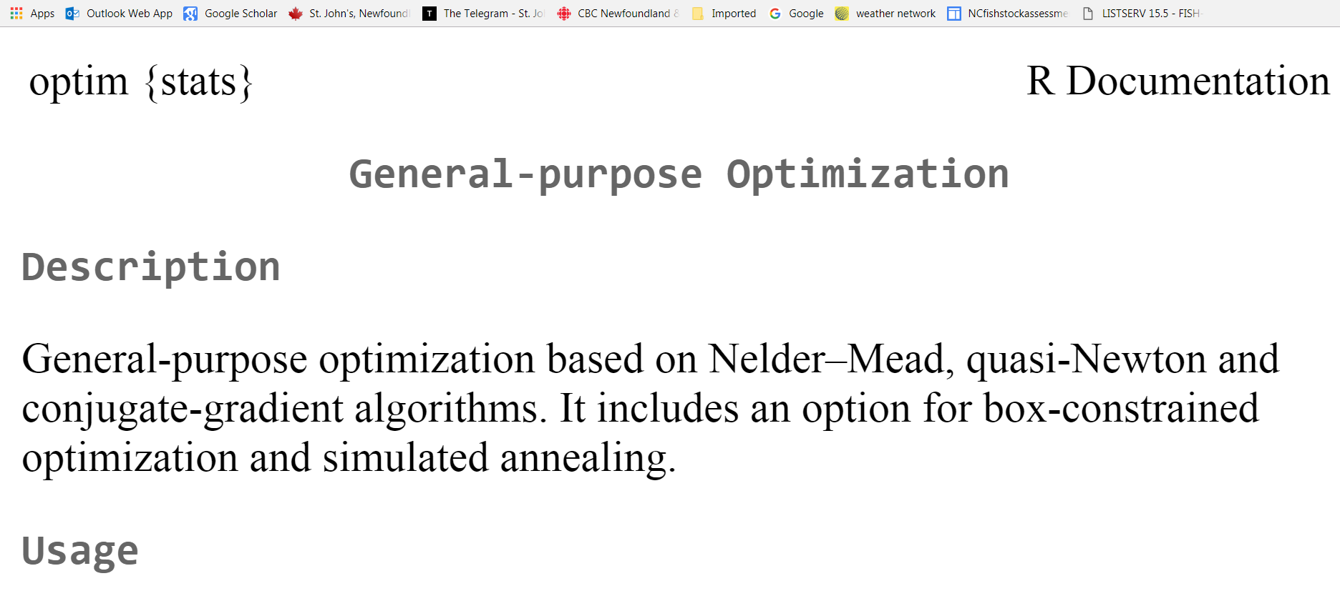
Optim()

Slide 39
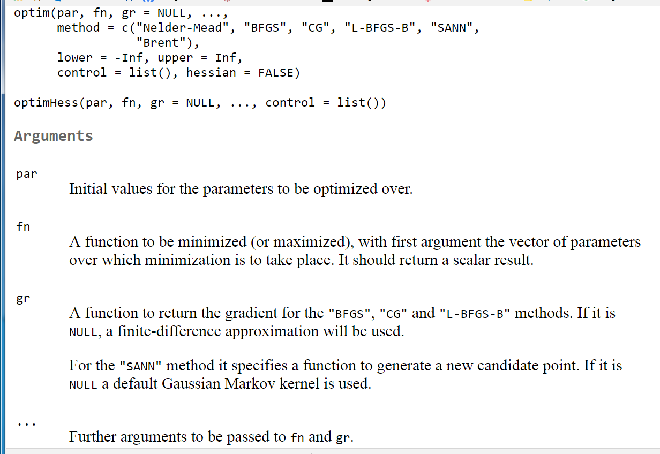
Optim()
The default method is an implementation of that of Nelder and Mead (1965), that uses only function values and is robust but relatively slow. It will work reasonably well for non-differentiable functions.

Slide 40
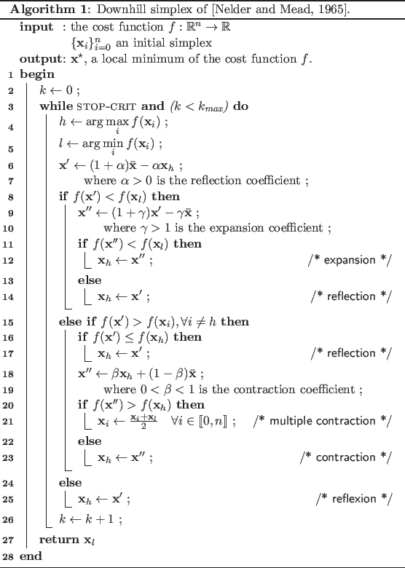

Slide 41
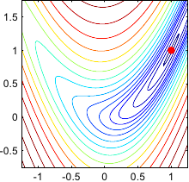
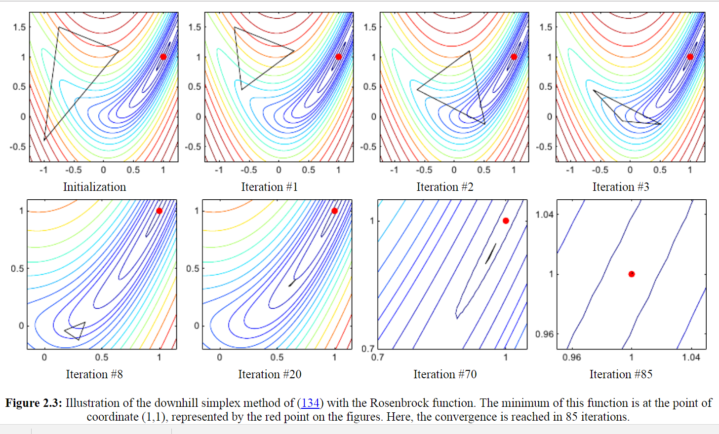
Figure: Contour plot of the Rosenbrock banana function.

Slide 42
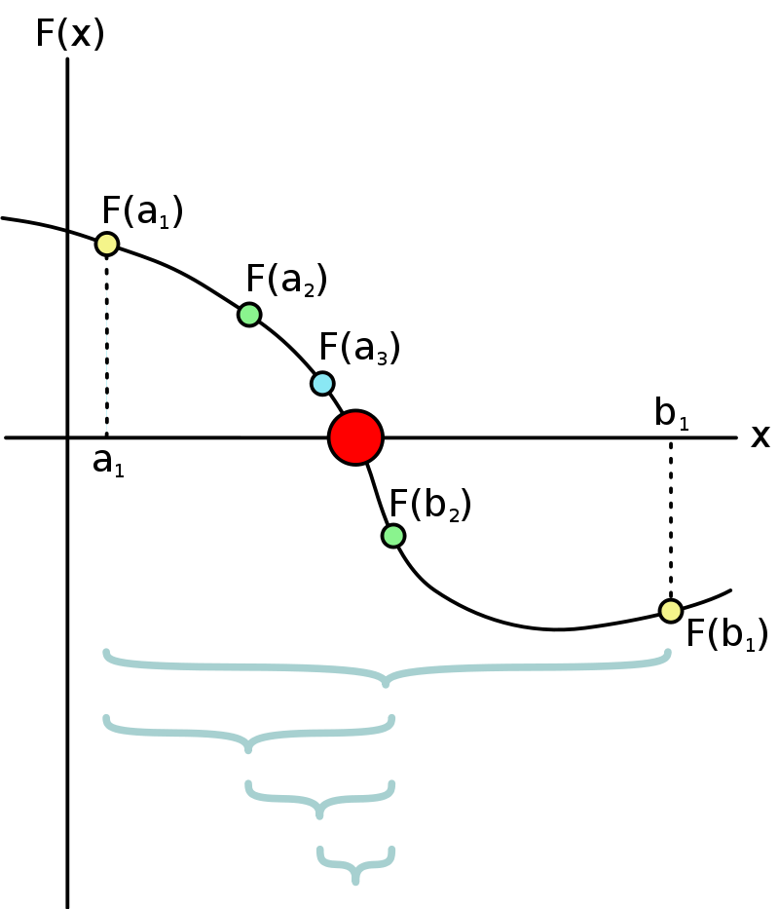
Bisection method
The bisection method is a root-finding method that repeatedly bisects an interval and then selects a subinterval in which a root must lie for further processing. It is a very simple and robust method, but it is also relatively slow.

Slide 43
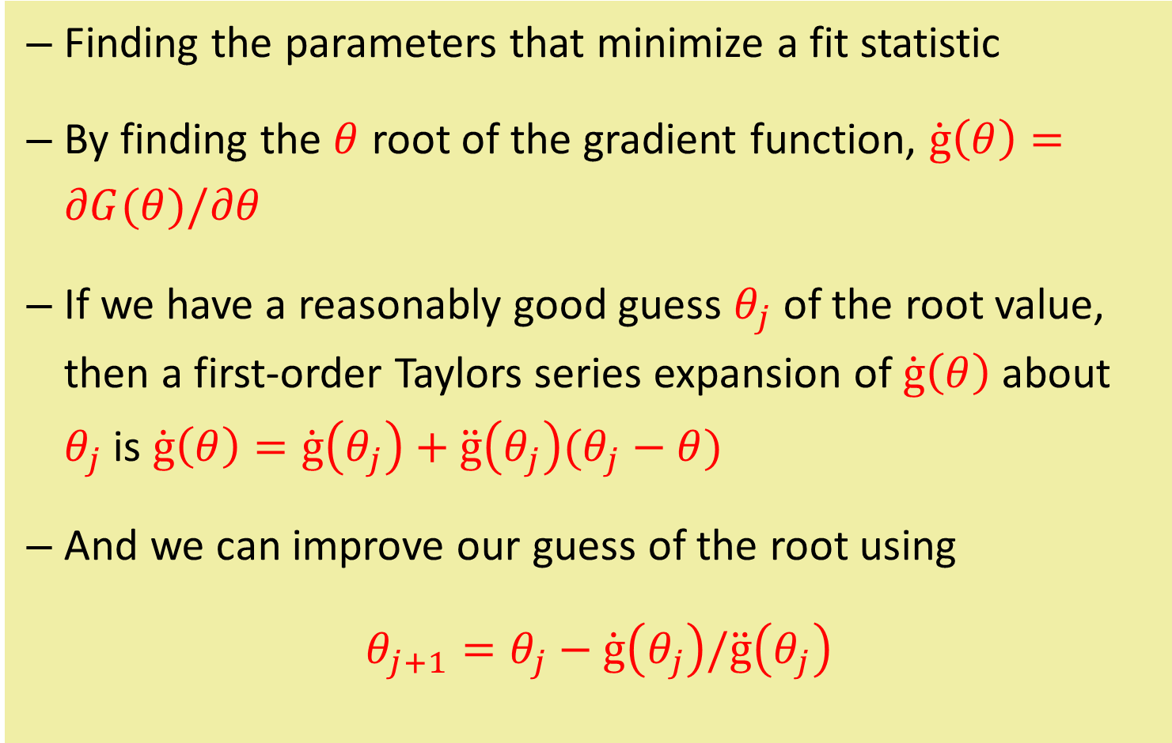
Function optimization: Newton’s Method
Finding the parameters that minimize a fit statistic
By finding the $θ$ root of the gradient function, $\dot{g}\left(θ\right)=∂G(θ)/∂θ$
If we have a reasonably good guess $θ_{j}$ of the root value, then a first-order Taylors series expansion of $\dot{g}\left(θ\right)$ about $θ_{j}$ is $\dot{g}\left(θ\right)=\dot{g}\left(θ_{j}\right)+\ddot{g}\left(θ_{j}\right)(θ_{j}−θ)$
And we can improve our guess of the root using
$θ_{j+1}=θ_{j}−\dot{g}\left(θ_{j}\right)/\ddot{g}\left(θ_{j}\right)$

Slide 44
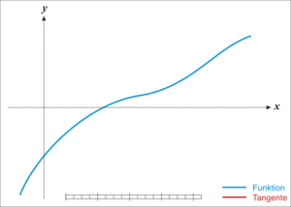
Newton’s root finding

Slide 45
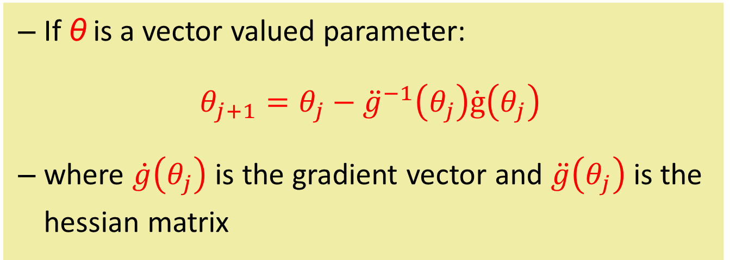
Newton’s method
If θ is a vector valued parameter:
$θ_{j+1}=θ_{j}−{\ddot{g}}^{−1}\left(θ_{j}\right)\dot{g}\left(θ_{j}\right)$
where $\dot{g}\left(θ_{j}\right)$ is the gradient vector and $\ddot{g}\left(θ_{j}\right)$ is the hessian matrix

Slide 46
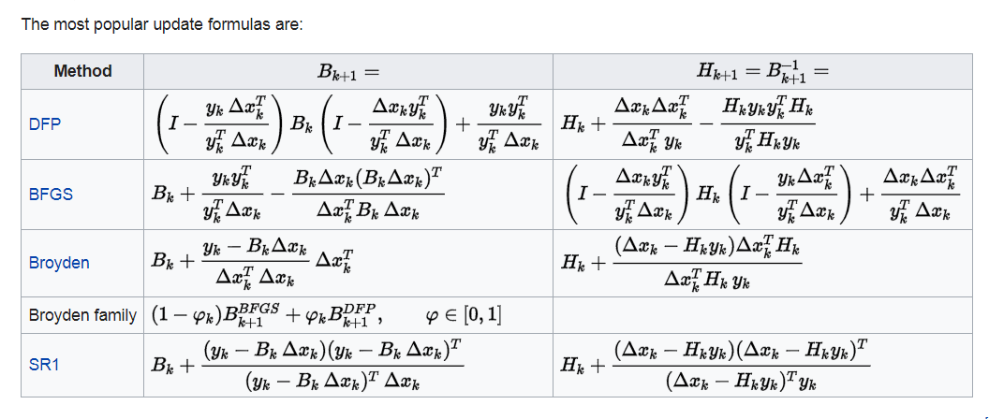
Quasi-Newton method
Quasi-Newton methods are used to either find zeroes or local maxima and minima of functions, as an alternative to Newton's method.
They can be used if the Jacobian or Hessian is unavailable or is too expensive to compute at every iteration.

Slide 47
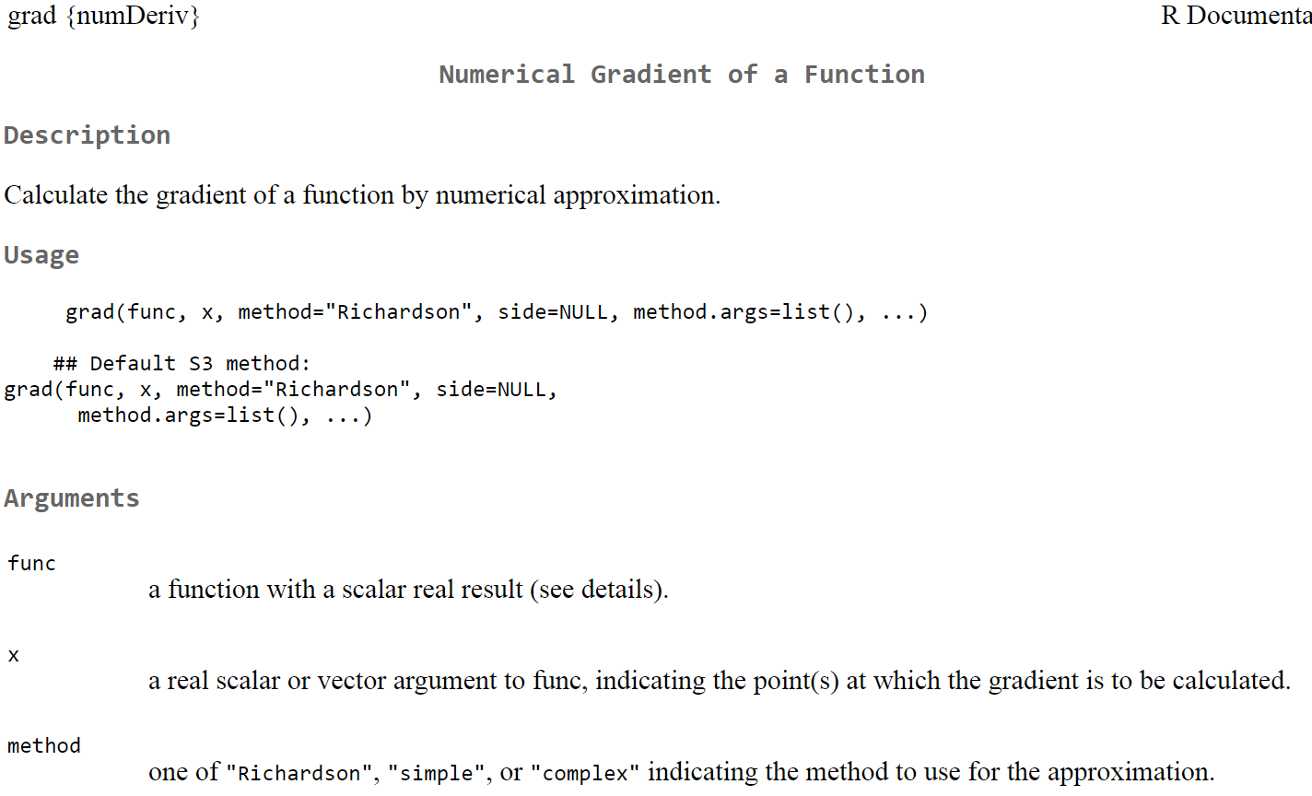
library(numDeriv)

Slide 48
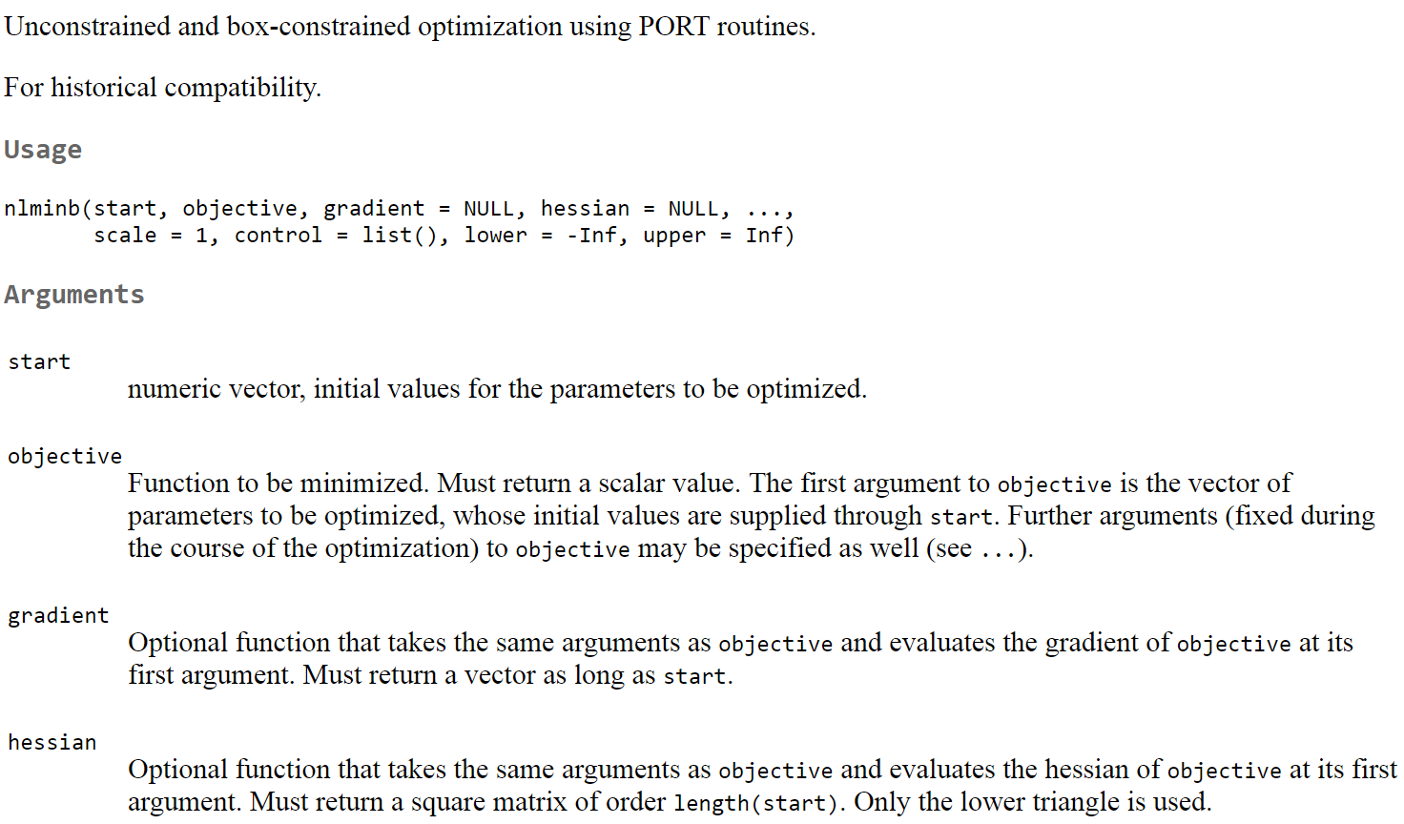
nlminb()
tend to find nlminb() is a better function minimzer

Slide 49
nlminb with length-weight data
> data.fit = nlminb(parm.start,LW_SSR)
> print(data.fit)
$par
[1] 2.201199 2.092770
$objective
[1] 2123.409
$convergence
[1] 0
$iterations
[1] 5
$evaluations
function gradient
6 14
$message
[1] "relative convergence (4)"
Optim results
$par
[1] 2.214256 2.092548
$value
[1] 2123.409
lsfit results
Intercept X
2.201257 2.092769

Slide 51
More general estimation
The least squares method is more appropriate for situations where you feel the errors are additive, and the errors have approximately the same variation
If you think your errors are multiplicative, then a log-transformation can make the errors additive,
but your model may no longer be linear
Log-transformations may not be good for count responses (i.e. 0’s? – can’t log), and proportions

Slide 52
More general estimation
The method of maximum likelihood is more general, and suitable for almost any type of data and model
Maximum likelihood estimates (MLE’s) of parameters are those values that maximize the likelihood of the data
The likelihood is a fit function based on the probability distribution of the responses
Covariates, like length, are not considered random.

Slide 53
Probability distribution
Is a mathematical function that you feel well describes the random variability in your response.
A coin toss: a probability distribution can give the probability (between 0 and 1) that you get 3 heads in 6 tosses, etc.
A cumulative distribution function (CDF) gives the probability that your response lies within some range of values
i.e. prob of getting 3 heads or more in 6 tosses

Slide 54
Probability density
There are some technical distinctions to how we describe probability for count responses versus real valued measurements (i.e. 1.2345, etc)
The probability of a specific value for a real valued measurement is technically zero, because there are uncountably many other potential values
unlike count data where the possible responses are countable and therefore can have specific probabilities
For real data, we examine probability for intervals

Slide 55
Probability density function
That is,
pdf(y) is the probability density function
you can think of it as giving the probability of y, but technically it gives the probability of a very small interval about y.
The ∫dy is integration, which is analogous to adding up over pdf(y) many small intervals about y.

Slide 56
Probability density function
Note that Pr(-∞ ≤ Y ≤ ∞) = 1.
The expected value, or mean, of a random variable Y is defined to be
It is a measure of the central location of Y
The variance of Y is
and is a measure of the spread of the possible values of the random variable Y

Slide 57
The normal pdf
Many people have heard of the normal distribution
It is commonly used to describe real valued measurements (length, weight, etc);
Less useful for counts and proportions
The normal pdf is
The mean is μ, and the variance is σ².
The standard deviation is σ = sqrt{Var(Y)}
μ and σ² are parameters of the pdf, usually they are unknown

Slide 58
The normal pdf
The normal distribution is symmetric about μ.
It is really easy in R to look at this
random.y = rnorm(n=1000,mean=10,sd=2)
hist(random.y)
abline(v=10,col='red')
Normal random number generator
Produce a histogram
The histogram gives the number of y’s (from the n=1000 generated) that are in each interval indicated on the x-axis; i.e. 200 y’s between 9 and 10, etc

Slide 59
The normal pdf
This was a large sample size, and
> mean(random.y)
[1] 9.993741
> var(random.y)
[1] 3.923442
> sqrt(var(random.y))
[1] 1.980768
True mean was 10, and true std. dev. was 2. A sample of size 1000 can give very precise estimates of population parameters

Slide 60
The normal pdf
Values close to the mean μ are more likely that values far from μ.
fraction of random y’s less than 7
fraction of random y’s >= 13
> n=1000
> length(random.y[random.y<=7])/n
[1] 0.063
> length(random.y[random.y>=13])/n
[1] 0.072
> length(random.y[(random.y>=9)&(random.y<=11)])/n
[1] 0.392
fraction of random y’s >=9 and <= 11
i.e. 392/1000=0.392

Slide 61
The normal pdf
It is easy to compute these probabilities exactly in R
Pnorm(…) computes Pr(Y ≤ q)
Note that Pr(q₁ ≤ Y ≤ q₂) = Pr(Y ≤ q₂) - Pr(Y ≤ q₁)
-
=
pnorm(11, mean=10, sd=2) - pnorm(9, mean=10, sd=2)
[1] 0.3829249
close to 0.392 for the 1000 random y’s

Slide 62
The normal pdf
Quantiles are also easy
A quantile is the value y_{α} such that Pr(Y ≤ y_{α}) = α
95% of values are less than 13.29, and 5% greater
> qnorm(0.95, mean=10, sd=2)
[1] 13.28971
> qnorm(0.05, mean=10, sd=2)
[1] 6.710293
>
5% of values are less than 6.71, and 95% are greater
90% of responses will be less than 13.29 but greater than 6.71; that is, Pr(6.71 ≤ Y ≤ 13.29) = 0.9
length(random.y[(random.y>=6.71)&(random.y<=13.29)])/n
[1] 0.902

Slide 63
Other pdf’s
For the beta distribution see dbeta.
For the binomial (including Bernoulli) distribution see dbinom.
For the Cauchy distribution see dcauchy.
For the chi-squared distribution see dchisq.
For the exponential distribution see dexp.
For the F distribution see df.
For the gamma distribution see dgamma.
For the geometric distribution see dgeom. (This is also a special case of the negative binomial.)
For the hypergeometric distribution see dhyper.
For the log-normal distribution see dlnorm.
For the multinomial distribution see dmultinom.
For the negative binomial distribution see dnbinom.
For the normal distribution see dnorm.
For the Poisson distribution see dpois.
For the Student's t distribution see dt.
For the uniform distribution see dunif.
For the Weibull distribution see dweibull.

Slide 64
The likelihood
For discrete data, the pdf gives the probability of observing the particular values in our data, given values for the parameters of the pdf.
For continuous data, the pdf gives the probability of observing the particular values in our data (really a very small range around the data values), given values for the parameters of the pdf.
For example, given values for the mean is μ, and the variance is σ², we can compute the normal pdf.

Slide 65
The likelihood
The likelihood is a function used to describe what values of the pdf parameters are more likely given the data we observe. It is a fit function.
Recall that we denote the set of parameters as θ.
Given an observed value of a random variable Y, the likelihood function for θ is L(θ|y_{obs}) = pdf(Y=y_{obs}| θ)
We denote random variables with upper case, and observations of the random variables with lower case
The | means given

Slide 66
The likelihood
If the have n independent observations then the likelihood is the product,
In general, the probability of independent events is the product of their individual probabilities.

Slide 67
The Normal likelihood
For n independent observations from a normal distribution with parameters μ and σ² for the mean and variance, the likelihood is

Slide 68
The likelihood
The likelihood function L(θ|y_{obs}) is a fit function, and we will use it to estimate values for θ that are “most likely” with the data we observe.
We will call these estimates the maximum likelihood estimates (MLE’s) of θ.
They will maximize L(θ|y_{obs}).
A useful fact: maximizing L(θ|y_{obs}) is the same as maximizing the log of L(θ|y_{obs}).

Slide 69
The likelihood
We will denote log{L(θ|y_{obs})} as l(θ|y_{obs}).
so lower case l means log of the likelihood, which is shortened to log-likelihood.
Many optimizers minimize by default, and this is no problem because the MLE of θ is simply the value of θ that minimizes the negative log-likelihood.
I will also use nll for negative log-likelihood

Slide 70
The Normal log-likelihood
For n observations from a normal distribution with parameters μ and σ² for the mean and variance, the log-likelihood is
I get tired of writing y₁,…,y_{n} so lets drop this, and remember that the likelihood depends on data
this can also be written as
The negative log-likelihood, nll

Slide 71
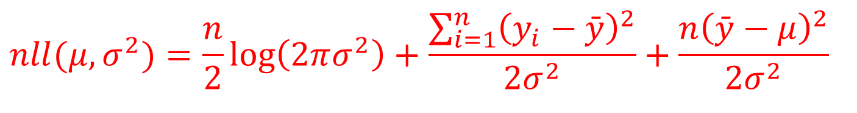
MLE for μ
$$nll(μ,σ^{2})=\frac{n}{2}\log\left(2πσ^{2}\right)+\frac{\sum_{i=1}^{n}{{\left(y_{i}−\bar{y}\right)}^{2}}}{2σ^{2}}+\frac{n{\left(\bar{y}−μ\right)}^{2}}{2σ^{2}}$$
Let denote the MLE for μ
For any value of σ², the nll is minimized when
This is obvious by inspection of the nll, but you could also take the derivative with respect to μ and then find the value of μ that makes the derivative 0. This will be . Try this if you remember how to do derivatives

Slide 72
MLE for σ²
It is not hard using the derivative method to show that
this estimator is a slight under-estimate of σ². An unbiased estimator is
bc means bias-corrected

Slide 73
MLE’s in R
This is straight-forward.
Need to write a function whose arguments are the parameters,
and the function returns the nll for the parameters

Slide 74
Normal MLE’s in R
μ = 5, σ² = 1
> n=20
> mu=5
> s2=1;
> y = rnorm(n=n,mean=mu,sd=sqrt(s2))
> ybar=mean(y)
> yvar = sum((y-ybar)^2)/n
> print(y,digits=3)
[1] 6.02 6.36 2.80 5.34 3.84 3.96 3.89 6.52 5.48 5.33
[11] 5.46 5.47 5.62 5.71 3.89 4.14 4.33 4.38 4.90 6.23
> print(ybar)
[1] 4.98454
> print(yvar)
[1] 0.989681
MLE of μ
MLE of σ²
n=20 random observations from a Normal distribution with μ = 5, σ² = 1

Slide 75
Minimize nll in R
the function to minimize
normal.nll <- function(parm){
mu = parm[1]
s2 = parm[2]
prob = dnorm(y,mean=mu,sd=sqrt(s2))
nll = -sum(log(prob))
return(nll)
}

Slide 76
Minimize nll in R
> parm.start = c(0,1)
> mle.fit = optim(parm.start,normal.nll)
Warning messages:
1: In sqrt(s2) : NaNs produced
2: In sqrt(s2) : NaNs produced
> print(mle.fit)
$par
[1] 4.9843782 0.9901456
$value
[1] 28.27505
$counts
function gradient
95 NA
$convergence
[1] 0
$message
NULL
need to give optim the name of the fit function you created
need to give optim starting values for the parameters
It works. You can check that these are close to the MLE’s of μ and σ² that we computed earlier using exact equations

Slide 77
Better Approach to estimate σ²
estimate log(σ²) and
σ² = exp(log(σ²))
parm[2] can be + or -, but s2 always +
normal.nll <- function(parm){
mu = parm[1]
s2 = exp(parm[2])
prob = dnorm(y,mean=mu,sd=sqrt(s2))
nll = -sum(log(prob))
return(nll)
}

Slide 78
Better Approach
> parm.start = c(3,0)
> mle.fit = optim(parm.start,normal.nll)
> print(mle.fit)
$par
[1] 4.98448207 -0.01014594
$value
[1] 28.27505
$counts
function gradient
63 NA
$convergence
[1] 0
$message
NULL
> exp(mle.fit$par[2])
[1] 0.9899054
estimate of log(σ²)
estimate of σ², which is close to the result we got before

Slide 79
Normal MLE’s
It turns out that MLE’s of regression parameters are the same as least squares estimates when the data are normally distributed with the same variance.
Lets check this with the growth data example.

Slide 80
Normal MLE’s for growth data example
fname = c("E:\\FRM6002_2011\\lecture5\\LW.dat")
tdata = read.table(fname,header=TRUE)
normal.nll <- function(parm){
mu= parm[1] + parm[2]*tdata$length
s2 = exp(parm[3])
prob = dnorm(tdata$weight,mean=mu,sd=sqrt(s2))
nll = -sum(log(prob))
return(nll)
}
returns pdf for weight, with mean mu and st. dev. sqrt(s2)
has to be either a scalar (single value) or a vector of length n

Slide 81
Normal MLE’s for growth data example
> parm.start = c(2,2,2)
> normal.nll(parm.start)
[1] 218.2105
> mle.fit = optim(parm.start,normal.nll,method = "BFGS",
+ control=list(maxit=1000,trace=1))
initial value 218.210452
iter 10 value 68.506295
iter 20 value 68.474572
final value 68.474551
converged
more efficient method
print some results during minimization
Needed to increase number of iterations

Slide 82
Normal MLE’s for growth data example
lsfit results
Intercept X
2.201257 2.092769
> print(mle.fit)
$par
[1] 2.202959 2.092741 4.770448
$value
[1] 68.47455
$counts
function gradient
48 22
$convergence
[1] 0
Also get an estimate of error variance
you can check that these are really close to what we computed earlier
0 is good – means it converged
> mle.fit = nlminb(parm.start,normal.nll)
> mle.fit
$par
[1] 2.201260 2.092769 4.770407

Slide 83
MLE’s
We have looked at R code to get MLE’s of the parameters of the linear model Y = θ_{o}+ θ₁*X + ε
We are now in good shape to get MLE’s for many types of models
Including the ones in Haddon
i.e. Lognormal, Gamma, Binomial, Poisson, ……
We don’t need to worry about writing computer code for pdf’s

Slide 84
Von Bertalanffy growth curve
The vonB growth curve (length vs age) is
L = L∞{1- exp(-K(age-a_{o})} + ε
The data are the length L at age
The parameters are
L∞ - maximum size,
K - growth rate parameter,
a_{o} - hypothetical age at zero length, and
ε is a random error term.

Slide 85
Von Bertalanffy growth curve

Slide 86
R estimation of vonB for ex 3.6 in Haddon
print(age)
[1] 1.0 2.0 3.3 4.3 5.3 6.3 7.3 8.3 9.3 10.3 11.3
> print(len)
[1] 15.40 26.93 42.23 44.59 47.63 49.67 50.87 52.30 54.77 56.43 55.88

Slide 87
R estimation of vonB for ex 3.6 in Haddon
normal.nll <- function(parm){
Linf = exp(parm[1])
K = exp(parm[2])
ao = exp(parm[3])
s2 = exp(parm[4])
mu = Linf*(1 - exp(-K*(age-ao)))
prob = dnorm(len,mean=mu,sd=sqrt(s2))
nll = -sum(log(prob))
return(nll)
}
a 4 x1 vector of parameters, all logged

Slide 88
R estimation of vonB for ex 3.6 in Haddon
> parm.start = c(4,-1,-10,0)
> mle.fit = optim(parm.start,normal.nll,method="BFGS",
> control=list(maxit=1000,trace=1))
initial value 29.733522
iter 10 value 19.485344
final value 19.485292
converged
> print(mle.fit)
$par
[1] 4.0376957 -1.0510839 -9.9973615 0.7048937
$value
[1] 19.48529
$counts
function gradient
44 14
$convergence
[1] 0
$message
NULL
> print(exp(mle.fit$par),digits=3)
[1] 5.67e+01 3.50e-01 4.55e-05 2.02e+00

Slide 89
Lognormal Distribution
Is commonly used in biology, for continuous valued measurements
It is appropriate when errors (ε’s) are multiplicative
Common to assume Y = μ·exp(ε), where ε has a normal distribution with mean zero and variance σ².
In this case the mean of Y is μ · exp(σ²/2), the median is μ, and the variance is complicated

Slide 90
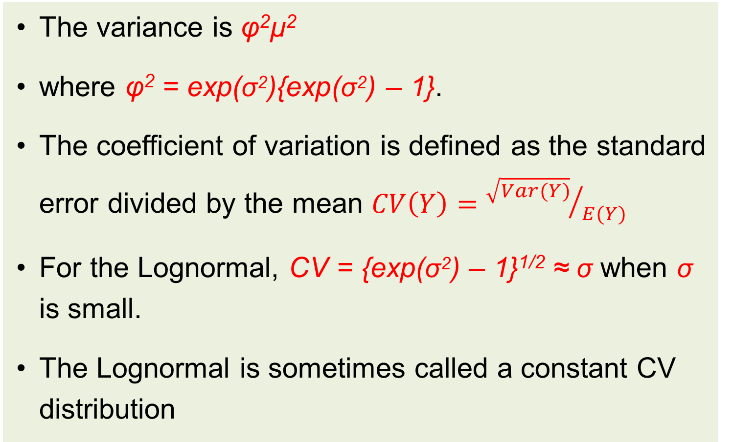
Lognormal Distribution
The variance is φ²μ²
where φ² = exp(σ²){exp(σ²) – 1}.
The coefficient of variation is defined as the standard error divided by the mean $CV\left(Y\right)={\sqrt{Var(Y)}}/{E(Y)}$
For the Lognormal, CV = {exp(σ²) – 1}^{1/2} ≈ σ when σ is small.
The Lognormal is sometimes called a constant CV distribution

Slide 91
Lognormal in R
Solve for in σ² in φ² = exp(σ²){exp(σ²) – 1}
Hint. Let X = exp(σ²) and complete the square: X² - X
mu=10
phi=0.4
sigma2 = log(0.5 + sqrt(phi**2 + 0.25))
n=100000
y = mu*exp(rnorm(n,mean=0,sd=sqrt(sigma2)))
An asymmetric distribution, with right skew (right tail longer than left tail)

Slide 92
Lognormal in R
> EY = mu*exp(sigma2/2)
> VY = (phi**2)*(mu**2)
> print(EY)
[1] 10.67854
> print(mean(y))
[1] 10.69479
> print(median(y))
[1] 10.03076
> print(VY)
[1] 16
> print(var(y))
[1] 15.89633
μ = 10, which is very close to the median. The mean is somewhat greater than μ.
true values

Slide 93
Lognormal variation increases with the mean
In the regression setting, when the mean is a function of covariates, then the lognormal distribution is often used when it seems that the error variance increases with the regression mean.
Lets look at an example of this, using the vonB growth curve.
Lets pretend we have ages and lengths for a 1000 fish – and the true vonB parameters are L∞= 55, K = 0.35, and a_{o}=0 .

Slide 94
Lognormal VonB data – the ages
n=1000
age = sort(rpois(n,lambda=6))
barplot(table(age),xlab='Age',ylab='Frequency',
main='Age Distribution')

Slide 95
Lognormal VonB data – the lengths
Linf=55
K=0.35
ao=-0.1
sigma=0.2
mu = Linf*(1 - exp(-K*(age-ao)))
len = rlnorm(n, meanlog = log(mu), sdlog = sigma)
plot(age,len,xlab='Age',ylab="Length",type='p',xlim=c(0,20))
lines(age,mu,lty=1,lwd=2,col='red')
Y = μ·exp(ε) implies log(Y) = log(μ) + ε,

Slide 96
Lognormal VonB data – the fit
vonb <- function(Linf,K,ao,age){
mu = Linf*(1 - exp(-K*(age-ao)))
return(mu)
}
lognormal.nll <- function(parm){
Linf = exp(parm[1])
K = exp(parm[2])
ao = parm[3]
sigma = exp(parm[4])
mu = vonb(Linf,K,ao,age)
prob = dlnorm(len,mean=log(mu),sd=sigma)
nll = -sum(log(prob))
return(nll)
}
parm.start = c(3,-1,-0.1,-1)
mle.fit = optim(parm.start,lognormal.nll)
pred.age = seq(0,20,by=0.1)
Linf.hat = exp(mle.fit$par[1])
K.hat = exp(mle.fit$par[2])
ao.hat = mle.fit$par[3]
pred.mu = vonb(Linf.hat,K.hat,ao.hat,pred.age)
lines(pred.age,pred.mu,lty=1,lwd=2,col='blue')
legend("bottomright",c("True","Estimated"),
lty=1,col=c('red','blue'),lwd=2)
Better practise to have different functions for (1) your model of the mean, and (2) fit function

Slide 97
Lognormal vonB for ex 3.6 in Haddon
print(age)
[1] 1.0 2.0 3.3 4.3 5.3 6.3 7.3 8.3 9.3 10.3 11.3
> print(len)
[1] 15.40 26.93 42.23 44.59 47.63 49.67 50.87 52.30 54.77 56.43 55.88
> parm.start = c(3,-1,-0.1,-1)
> mle.fit = optim(parm.start,lognormal.nll)
> print(mle.fit$par)
[1] 4.0265506 -0.9627808 0.1660191 -3.4528217
> print(mle.fit$converge)
[1] 0
> vonb.parms = c(exp(mle.fit$par[1]),exp(mle.fit$par[2]),
+ mle.fit$par[3])
> names(vonb.parms) = c('Linf','K','ao')
> print(vonb.parms,digits=2)
Linf K ao
56.07 0.38 0.17
> sigma = exp(mle.fit$par[4])
> print(sigma)
[1] 0.03165618
$par
[1] 4.0376957 -1.0510839 -9.9973615 0.7048937

Slide 98
Gamma Distribution
Can be used in situations where you feel a constant CV model is appropriate
That is, when the variance is proportional to the square of the mean
It may be a more robust distribution than lognormal
Usually gives similar results, unless the CV is large

Slide 99
Gamma vonB for ex 3.6 in Haddon
gamma.nll <- function(parm){
Linf = exp(parm[1])
K = exp(parm[2])
ao = parm[3]
sigma = exp(parm[4])
mu = vonb(Linf,K,ao,age)
var = (sigma*mu)**2
s = var/mu
a = mu/s;
prob = dgamma(len,shape=a,scale=s)
nll = -sum(log(prob))
return(nll)
}
get R help on dgamma, to see how shape and scale are related to mean and variance

Slide 100
Gamma vonB for ex 3.6 in Haddon
> parm.start = c(5,-1,-0.1,-1)
> mle.fit = optim(parm.start,gamma.nll)
> print(mle.fit$par)
[1] 4.0262464 -0.9588169 0.1689758 -3.4481118
> print(mle.fit$converge)
[1] 0
> vonb.parms = c(exp(mle.fit$par[1]),exp(mle.fit$par[2]),
+ mle.fit$par[3])
> names(vonb.parms) = c('Linf','K','ao')
> print(vonb.parms,digits=2)
Linf K ao
56.05 0.38 0.17
> sigma = exp(mle.fit$par[4])
> print(sigma)
[1] 0.03180564
estimates are really similar to lognormal

Slide 101
Binomial distribution
Is a distribution used for counts
where you are interested in the number of times an “event” occurs in n trials or observations
i.e. number of mature fish in a sample of size n
number of fish caught from n that contact the fishing gear
the number of tagged fish caught from n releases

Slide 102
Binomial distribution
If the probability of the event happening, referred to as a “success”, is p,
and if this probability is the same for each of the n trials or observation events
and if Y is the number of successes in n trials, then
where x! = x*(x-1)*(x-2)*…*2*1
E(Y)=np, Var(Y) = np(1-p)

Slide 103
Binomial distribution – Maturity example
> matdata = read.table(fname,header=TRUE)
> print(matdata)
sex year age prop n cohort y
1 5 1995 2 0.00000 2 1993 0
2 5 1996 3 0.00000 73 1993 0
3 5 1997 4 0.23471 14 1993 3
4 5 1998 5 0.36244 18 1993 7
5 5 1999 6 0.78855 43 1993 34
6 5 2000 7 0.94920 33 1993 31
7 5 2001 8 1.00000 21 1993 21
8 5 2002 9 1.00000 15 1993 15
9 5 2003 10 1.00000 4 1993 4
10 5 2004 11 1.00000 5 1993 5
11 5 2005 12 1.00000 3 1993 3

Slide 104
Binomial logistic regression
Maturity should increase with age for a cohort
ie once fish become mature they cannot become immature again
Common to model the proportion mature at age using a logistic function
p(age) increases smoothly as a function of age

Slide 105
Proportion mature

Slide 106
Binomial logistic regression - maturity
pmat <- function(parm,age){
logitp = parm[1] + parm[2]*age
prob.mat = exp(logitp)/(1+exp(logitp))
return(prob.mat)
}
binomial.nll <- function(parm){
prob.mat = pmat(parm,age);
prob = dbinom(y,n,prob.mat)
nll = -sum(log(prob))
return(nll)
}
y = matdata$y
n = matdata$n
age = matdata$age
logistic R function
Binomial nll R function
R code to estimate the parameters for the logistic maturity model
> parm.start = c(-4,1)
> mle.fit = optim(parm.start,binomial.nll)
> print(mle.fit$par)
[1] -9.474728 1.801821
> print(mle.fit$converge)
[1] 0
required for Binomial nll

Slide 107
Plot the regression results
pred.prob = pmat(mle.fit$par,age)
lines(matdata$age,pred.prob,type='l',lwd=2,col='red')

Slide 108
Better plot of regression results
age.pred = seq(min(matdata$age),max(matdata$age),length=200)
pred.prob1 = pmat(mle.fit$par,age.pred)
lines(age.pred,pred.prob1,type='l',lwd=2,col='blue')
legend('bottomright',lty=1,lwd=2,col=c('black','red','blue'),
c("observed","predicted","smooth predicted"))

Slide 109
Binomial logistic regression
This model falls in the class of generalized linear models (GLIMs)
A linear regression with covariates (e.g. age, etc) that is related to responses via a link function
Can handle many types of distributions
including the Binomial
R has the GLM package for this
Gives statistics (confidence intervals, etc)

Slide 110
Binomial logistic regression
the linear part
the logit “link” function that links p to age

Slide 111
Binomial logistic regression - maturity
Binfit <- glm(cbind(y,n-y) ~ age,family=binomial(link = "logit"),data=matdata)
> temp = summary(Binfit)
> print(temp$coefficients)
Estimate Std. Error z value Pr(>|z|)
(Intercept) -9.475 1.3359 -7.092 1.319e-12
age 1.802 0.2413 7.468 8.132e-14
Pr(Z>|z value|) + Pr(Z<-|z value|)
=2Pr(Z<-|z value|)
> 2*pnorm(-7.092)
[1] 1.321875e-12
square root of the variance of the estimate
estimate/std.error – gives an indication how different the estimate is from 0
> print(mle.fit$par)
[1] -9.474728 1.801821

Slide 112
confidence interval (CI)
Is a statistic – a function of the data
A random interval that contains the true value of a parameter with a specific probability
If θ* is the true but unknown value of θ
Then a 100*(1-2α) CI for θ, (L,U), has the property
Pr(L < θ* < U) = 1- 2α
so if α=0.025, a 95% CI has the property
Pr(L < θ* < U) = 0.95

Slide 113
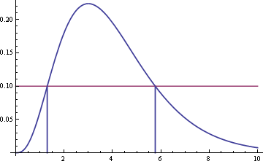
confidence interval (CI)
Pr(L < θ* < U) = 1- α is a two-sided interval
A one-sided interval: Pr(-∞ < θ* < U) = 1- α or Pr(L< θ* < ∞)
An equal-tailed two-sided CI:
Pr(L < θ* < U) = 1- α, Pr(θ* < L) = α/2, Pr(θ* >U) = α/2
Shortest CI may not be equal-tailed for asymentric distributions

Slide 114
confidence interval (CI)
Often a good approximate 100*(1-2α) CI is
estimate ± std.err x Z_{1-α} – normal approximation CI
where Z_{1-α} is the (1-α)th percentile from a normal distribution
Z_{1-α} for a 95% CI
> qnorm(0.975)
[1] 1.959964
> qnorm(0.95)
[1] 1.644854
> qnorm(0.995)
[1] 2.575829
Z_{1-α} for a 90% CI
Z_{1-α} for a 99% CI

Slide 115
Binomial logistic regression - maturity
Binfit <- glm(cbind(y,n-y) ~ age,family=binomial(link = "logit"),data=matdata)
> temp = summary(Binfit)
> print(temp$coefficients)
Estimate Std. Error z value Pr(>|z|)
(Intercept) -9.475 1.3359 -7.092 1.319e-12
age 1.802 0.2413 7.468 8.132e-14
95% CI : -9.475 ± 1.3359x1.96 = (-12.093, -6.857)

Slide 116
CI in R
An R function that returns a normal approximation CI for some regression stored in an R object (e.g. Binfit)
> confint.default(Binfit)
2.5 % 97.5 %
(Intercept) -12.092945 -6.856308
age 1.328946 2.274693
> confint.default(Binfit, level=0.99)
0.5 % 99.5 %
(Intercept) -12.915681 -6.033573
age 1.180358 2.423281
> confint.default(Binfit, level=0.9)
5 % 95 %
(Intercept) -11.671989 -7.277265
age 1.404972 2.198667

Slide 117
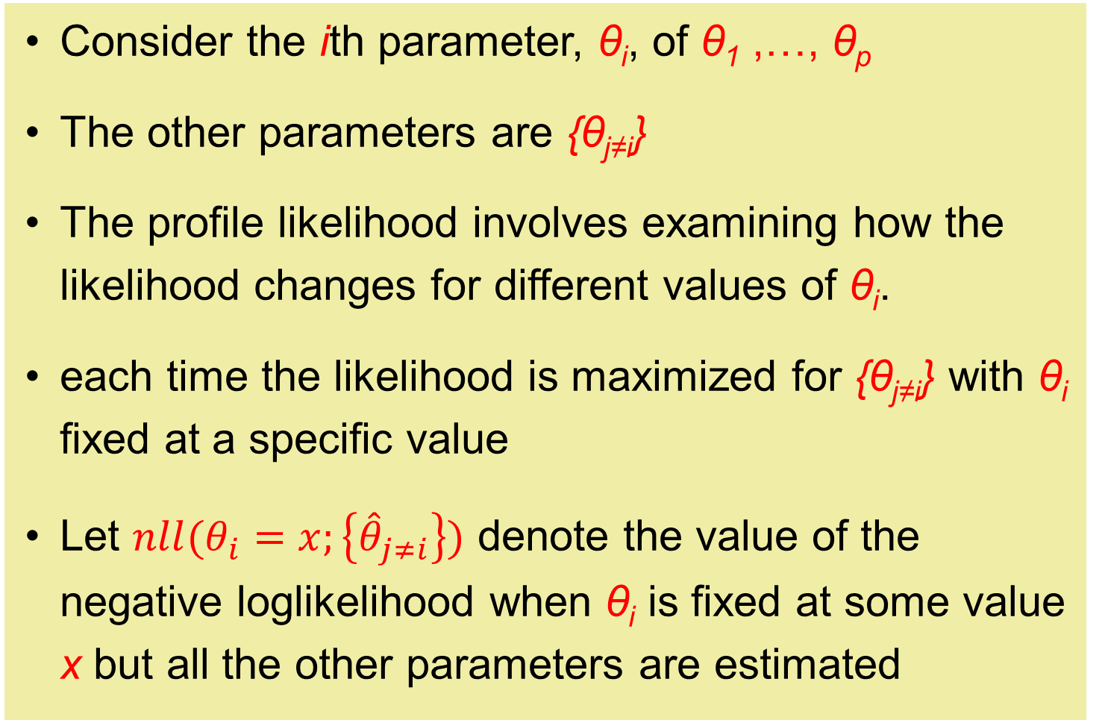
Profile likelihood CI
Consider the ith parameter, θ_{i}, of θ₁ ,…, θ_{p}
The other parameters are {θ_{j≠i}}
The profile likelihood involves examining how the likelihood changes for different values of θ_{i}.
each time the likelihood is maximized for {θ_{j≠i}} with θ_{i} fixed at a specific value
Let $nll(θ_{i}=x;\left\{{\hat{θ}}_{j≠i}\right\})$ denote the value of the negative loglikelihood when θ_{i} is fixed at some value x but all the other parameters are estimated

Slide 118
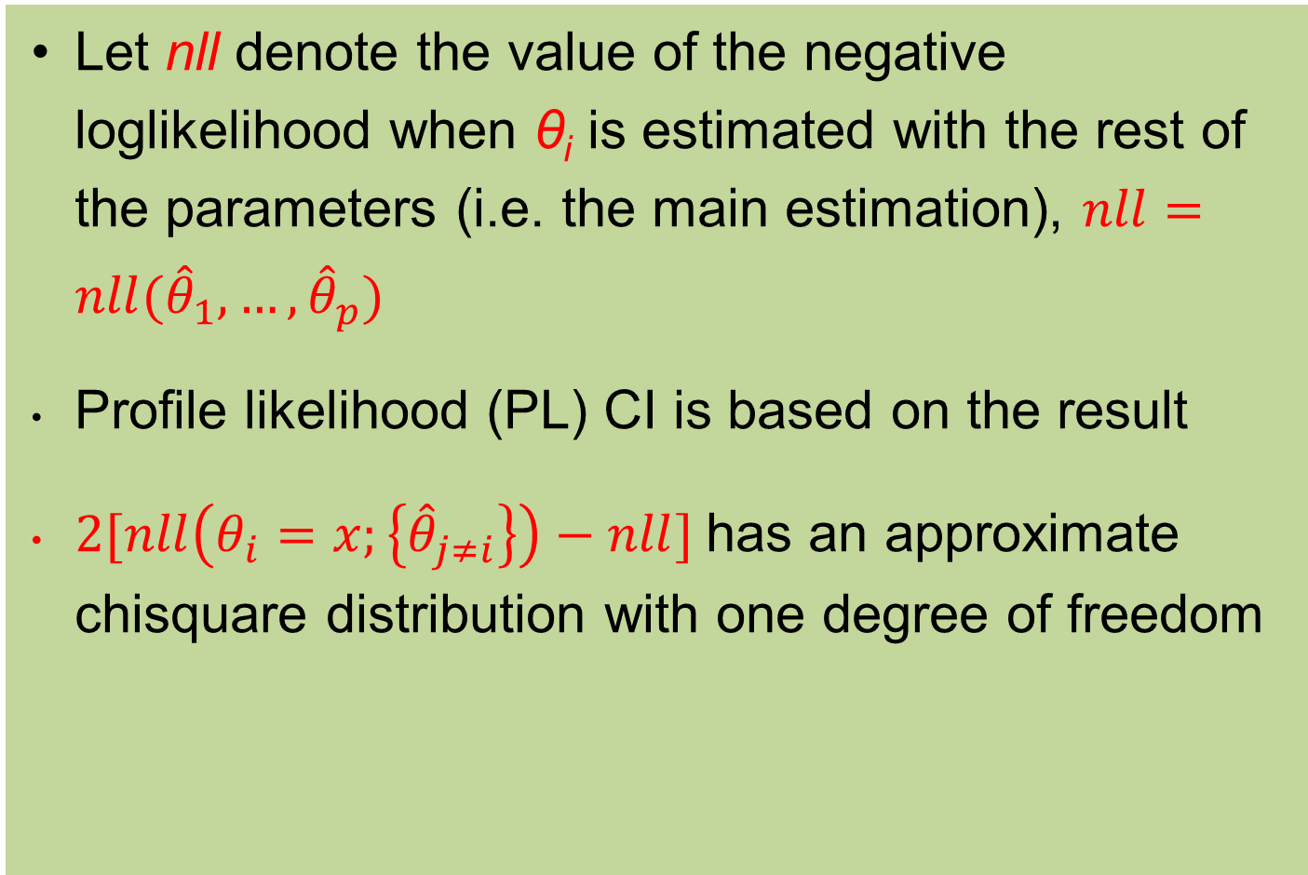
Profile likelihood CI
Let nll denote the value of the negative loglikelihood when θ_{i} is estimated with the rest of the parameters (i.e. the main estimation), $nll=nll({\hat{θ}}_{1},…,{\hat{θ}}_{p})$
Profile likelihood (PL) CI is based on the result
$2[nll\left(θ_{i}=x;\left\{{\hat{θ}}_{j≠i}\right\}\right)−nll]$has an approximate chisquare distribution with one degree of freedom
> qchisq(0.95,1)
[1] 3.841459

Slide 119
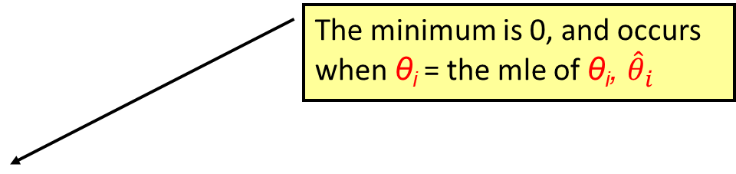
PL for the maturity data slope
qchisq(0.95,1)
The minimum is 0, and occurs when θ_{i} = the mle of θ_{i}, ${\hat{θ}}_{i}$

Slide 120
in R
> confint(Binfit)
Waiting for profiling to be done...
2.5 % 97.5 %
(Intercept) -12.495493 -7.183837
age 1.384860 2.343543
> confint.default(Binfit)
2.5 % 97.5 %
(Intercept) -12.092945 -6.856308
age 1.328946 2.274693
> confint(Binfit, level=0.99)
Waiting for profiling to be done...
0.5 % 99.5 %
(Intercept) -13.628814 -6.580419
age 1.273764 2.545387
> confint(Binfit, level=0.9)
Waiting for profiling to be done...
5 % 95 %
(Intercept) -11.951473 -7.512638
age 1.445114 2.246418

Slide 121
Bayesian Probability
Read about this in Haddon
It is a different basis of statistical inference in which parameters are considered to be random, and the data are fixed
It involves specifying “prior distributions” for the parameters, that are modified or updated based on the data collected
the use of priors is controversial

Slide 122
Bayesian Probability
Priors are a difficulty, especially multivariate priors
We should be robust to subjectivity
Potential for false precision
But sometimes I find a small number of objective priors helpful
Objective priors are just a likelihood component for me (see F6005)

Slide 123
Bayesian Probability
My inference is still frequentist
You can simulation test frequentist inference, so there is an objective interpretation
Bayesian probability: is interpreted either as 1) reasonable expectation representing a state of knowledge, or 2) as quantification of a personal belief (Wikipedia)
It is not completely honest to explain Bayesian probability using frequentist concepts.

Slide 124
Foundations of Frequentist statistical inference (not Bayesian)
lets go back to the basics to understand what is going on with CI’s
The basis of frequentist statistical inference is the distribution generated by applying your model and parameter estimation method to many, many, data-sets
We imagine these data-sets – they are not real

Slide 125
Foundations of Frequentist inference
In Lab 1 you had an example of this in the survey sampling context. You looked at all possible samples from a small finite population,
and verified that the mean from a random sample of size n was an unbiased estimator for the mean of the entire population (of size N >> n)
You also verified that the variance formula gave the variance of means generated from all possible samples

Slide 126
Foundations of Frequentist inference
Lets say that our problem involves estimating some parameter θ,
Assume we have a sample of n observations from a population with a very large size, so that we can assume that we are sampling from an infinite population
Let s denote the set of observations,
s = (y₁,…,y_{n})

Slide 127
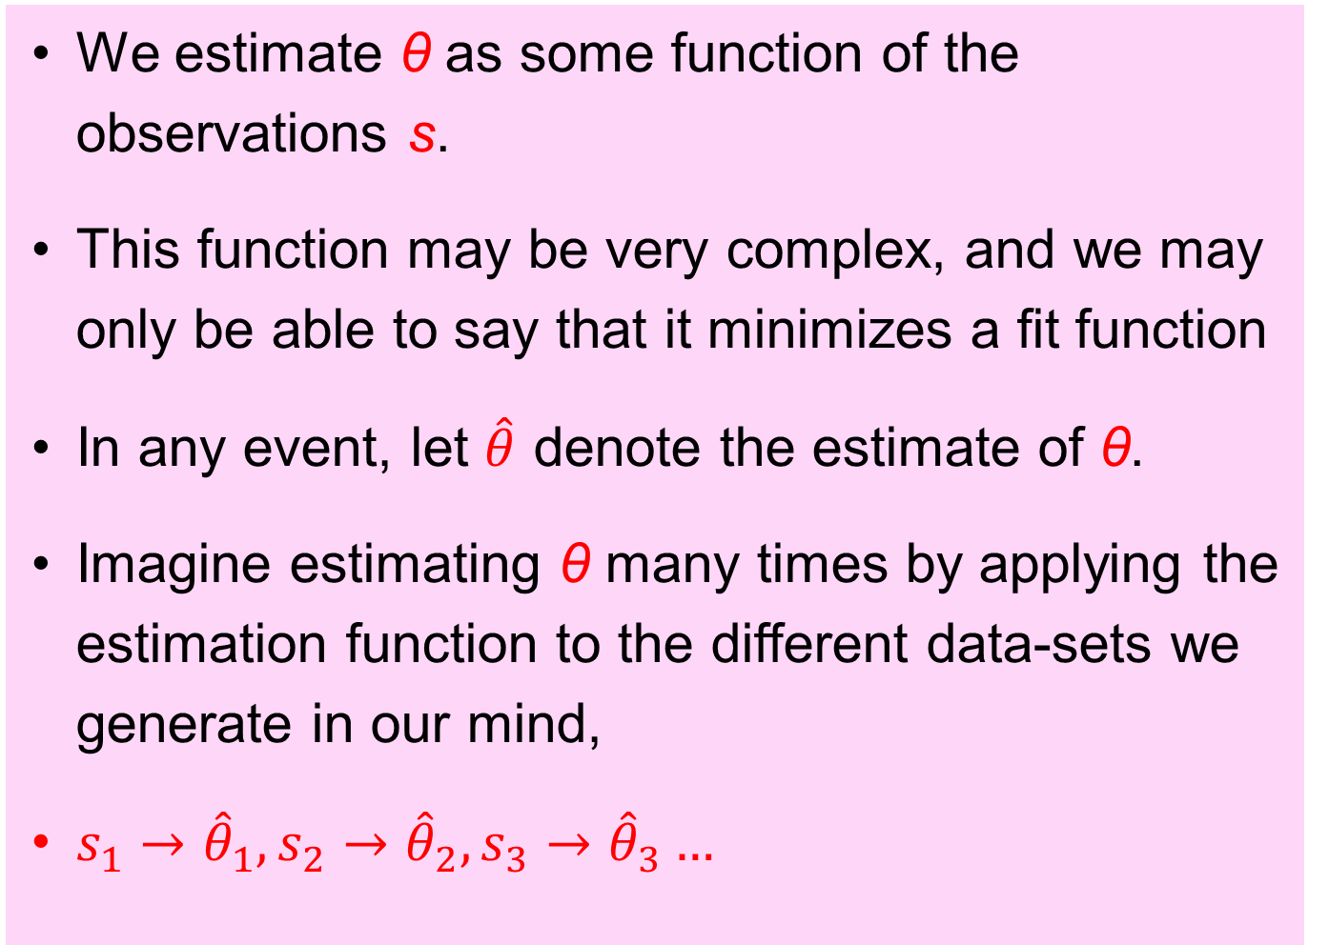
Foundations of Frequentist inference
We estimate θ as some function of the observations s.
This function may be very complex, and we may only be able to say that it minimizes a fit function
In any event, let $\hat{θ}$ denote the estimate of θ.
Imagine estimating θ many times by applying the estimation function to the different data-sets we generate in our mind,
$s_{1}→{\hat{θ}}_{1},s_{2}→{\hat{θ}}_{2},s_{3}→{\hat{θ}}_{3}…$

Slide 128
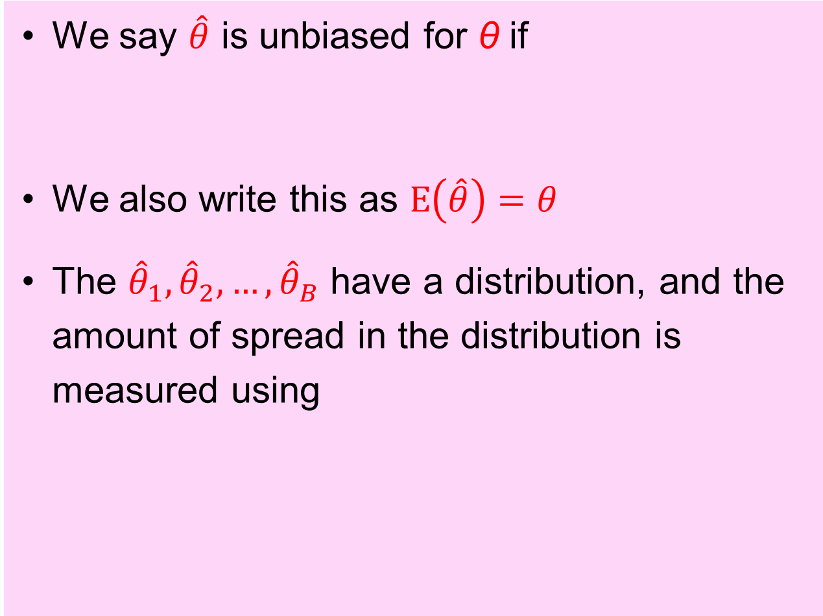
Foundations of Frequentist inference
We say $\hat{θ}$ is unbiased for θ if
We also write this as $E\left(\hat{θ}\right)=θ$
The ${\hat{θ}}_{1},{\hat{θ}}_{2},…,{\hat{θ}}_{B}$ have a distribution, and the amount of spread in the distribution is measured using

Slide 129
simple example
If θ=p for a Binomial distribution with size n=30 and true probability of success p=0.42
Statistical theory tells us that the mean and variance of this Binomial distribution is

Slide 130
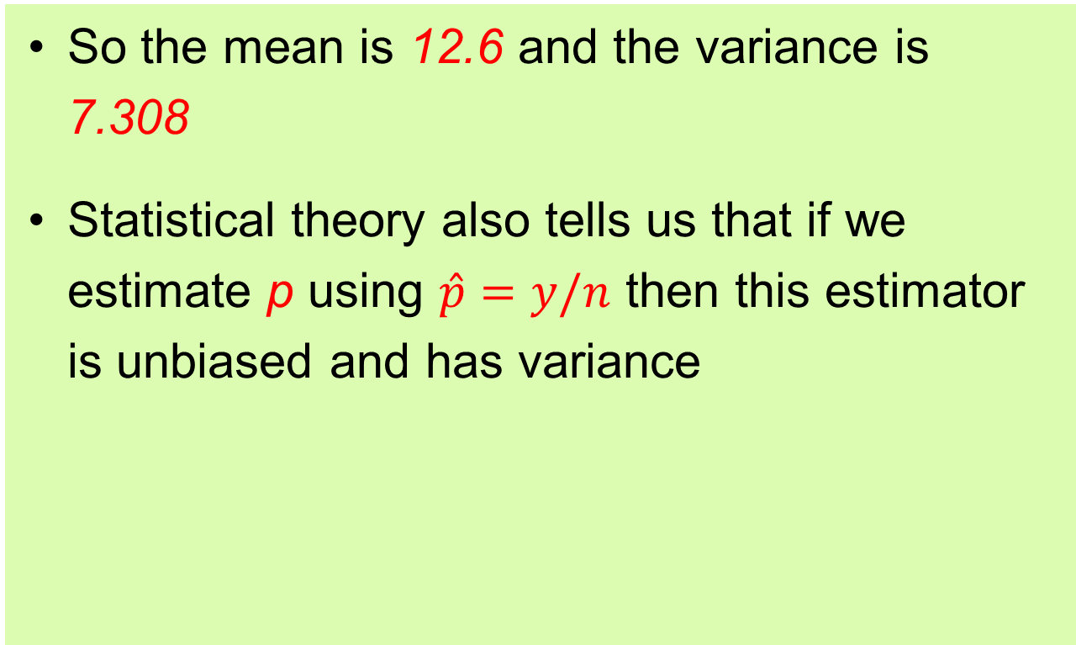
simple example
So the mean is 12.6 and the variance is 7.308
Statistical theory also tells us that if we estimate p using $\hat{p}=y/n$ then this estimator is unbiased and has variance

Slide 131
simple example results
> y = rbinom(10000,30,0.42)
> phat = y/30
> temp= table(phat)
> barplot(temp,main='Frequency of phat')
> E.phat = mean(phat)
> var.phat = var(phat)
> print(E.phat)
[1] 0.41892
> print(var.phat)
[1] 0.008015946
10000 estimates of p
looks like a normal distribution

Slide 132
simple example
We can see that the sampling distribution of looks Normal with mean p and variance p(1-p)/n
If we subtract off the mean and divide by square root of the variance then the sampling distribution should look Normal with mean 0 and variance 1
That is,

Slide 133
simple example
We can use the normal approximation to produce a confidence interval for p,
The upper confidence interval, P.U, is given by Z(P.U) = Z_{α/2} = - Z_{1-α/2}, and the lower interval is given by Z(P.L) = Z ₁₋ _{α/2}

Slide 134
simple example
p=0.42;n=30
Zphat = (as.numeric(names(temp))-p)/sqrt(p*(1-p)/n)
temp2=barplot(temp/10000,main='Frequency of (phat)',names.arg=round(Zphat,digits=2),
ylim=c(0,0.15))
pt = dnorm(Zphat,0,1)
lines(x=temp2,pt/sum(pt),col='red',lwd=3)
Zphat = (phat-p)/sqrt(p*(1-p)/n)
qqnorm(Zphat)
qqline(Zphat)

Slide 135
simple example
This can be solved algebraically, but it is a pain
> n=30
> y = rbinom(1,n,0.42)
> print(y)
[1] 10
> phat = y/n
> print(phat)
[1] 0.3333333
>
> Zp = function(p,Z,n){
+ sd =sqrt(p*(1-p)/n)
+ ret = (phat - p)/sd - Z
+ return(ret)
+ }
bounds on the root of Zp
> alpha = 0.05
> Za = qnorm(alpha/2)
> ciroot=uniroot(Zp,c(0.01,0.99),Z=Za,n=30)
> pU.95 = ciroot$root
> ciroot=uniroot(Zp,c(0.01,0.99),Z=-Za,n=30)
> pL.95 = ciroot$root
> ci = c(pL.95,pU.95)
> print(ci)
[1] 0.1923031 0.5121984
other inputs to Zp
a 95% CI for p
uniroot finds the value of p that makes Zp return 0

Slide 136
simple example
Another less accurate approach is to estimate the variance in the CI statistic,
A (1-α)100% CI for p is given by
When y=10 and n=30, phat=1/3 and the CI is
This is close to the CI on the previous slide
0.1646465 0.5020202
> print(ci)
[1] 0.1923031 0.5121984

Slide 137
simple example simulation
I simulated 30 CI’s using the same R code
these 2 CI’s may not contain p=0.42
[,1] [,2]
[1,] 0.27 0.61
[2,] 0.42 0.75
[3,] 0.30 0.64
[4,] 0.30 0.64
[5,] 0.25 0.58
[6,] 0.30 0.64
[7,] 0.17 0.48
[8,] 0.36 0.70
[9,] 0.27 0.61
[10,] 0.19 0.51
[,1] [,2]
[1,] 0.17 0.48
[2,] 0.27 0.61
[3,] 0.27 0.61
[4,] 0.42 0.75
[5,] 0.36 0.70
[6,] 0.17 0.48
[7,] 0.27 0.61
[8,] 0.30 0.64
[9,] 0.27 0.61
[10,] 0.30 0.64
[,1] [,2]
[1,] 0.25 0.58
[2,] 0.25 0.58
[3,] 0.27 0.61
[4,] 0.25 0.58
[5,] 0.30 0.64
[6,] 0.22 0.54
[7,] 0.22 0.54
[8,] 0.17 0.48
[9,] 0.19 0.51
[10,] 0.27 0.61

Slide 138
simple example 1000 simulation
I ran the simulation 1000 times.
The fraction that exceeded the 1st CI method was 0.028 for the lower bound, and 0.021 for the upper bound.
This is very close to the intended 0.025 level
The exact same result for the 2nd CI method.
So both intervals, although they are different, have the same coverage probability

Slide 139
simple example 1000 simulation
when the true p = 0.2 the
The probability of exceeding the 1st CI method was 0.03 for the lower bound, and 0.012 for the upper bound. Not bad.
The probability of exceeding the 2nd CI method was 0.01 for the lower bound, and 0.05 for the upper bound.
The total coverage error is OK, but the one-sided errors are considerably different from 0.025

Slide 140
Computer intensive methods
There are many methods for statistical inference (i.e. confidence intervals, hypothesis tests) that rely on computer intensive simulation methods.
They tend to mimic in various ways the values of estimators we would get with repeated sampling.

Slide 141
Randomization methods
Haddon discusses these methods in more detail than most stats books do
They are more applicable to hypothesis testing in which you formulate a null hypothesis, and some appropriate test statistic that is large when the null hypothesis is false
The hypothesis is usually related to a change in some characteristic across groups in your population.

Slide 142
Randomization methods
A randomization test is derived by randomly re-allocating the data to groups, and computing the test statistic
This is done many times, with different re-allocations each time,
and this generates a distribution for the test statistic that you can use to decide if the statistic based on the actual observations is large enough to reject the null hypothesis.

Slide 143
Randomization methods
I rarely see randomization methods used, so I won’t say much about them
or consider examples
Randomization methods are not straight-forward for the regression case, or for CI’s for parameters
You can read Haddon for more information

Slide 144
Bootstrap methods
These are widely used methods for generating estimates of the distribution of a parameter estimator, or the distribution of a hypothesis test statistic or a confidence interval statistic
They are computer intensive, and involve various strategies to resample based only on the observed data
There are books on bootstrap, and I will just give an overview for some simple cases, for now

Slide 145
One sample mean
Consider the single sample situation where you have a sample s = (y₁,…,y_{n}) of size n from a population
Assume Y ~ N(μ,σ²) – Y is normal with mean μ and variance σ².
If σ² is known the “best” statistic to get CI’s for μ is
Similar to before, CI =
an exact result for N(μ,σ²) data, and a good approach otherwise when n is large

Slide 146
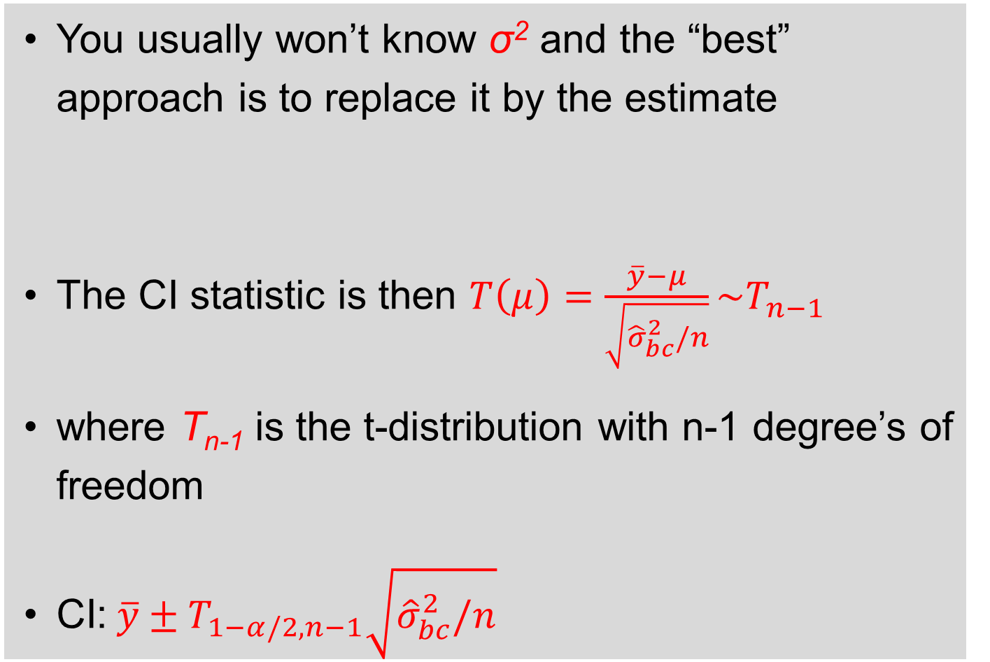
One sample mean
You usually won’t know σ² and the “best” approach is to replace it by the estimate
The CI statistic is then $T\left(μ\right)=\frac{\overline{y}−μ}{\sqrt{{\hat{σ}}_{bc}^{2}/n}}\sim T_{n−1}$
where T_{n-1} is the t-distribution with n-1 degree’s of freedom
CI:$\overline{y}±T_{1−α/2,n−1}\sqrt{{\hat{σ}}_{bc}^{2}/n}$
an exact result for N(μ,σ²) data, and a good approach otherwise when n is large

Slide 147
One sample mean
The t-distribution is similar to a Normal distribution, with wider tails when n is small that accounts for the additional uncertainty in the T-statistic because of estimating σ².
tails get wider when n is smaller

Slide 148
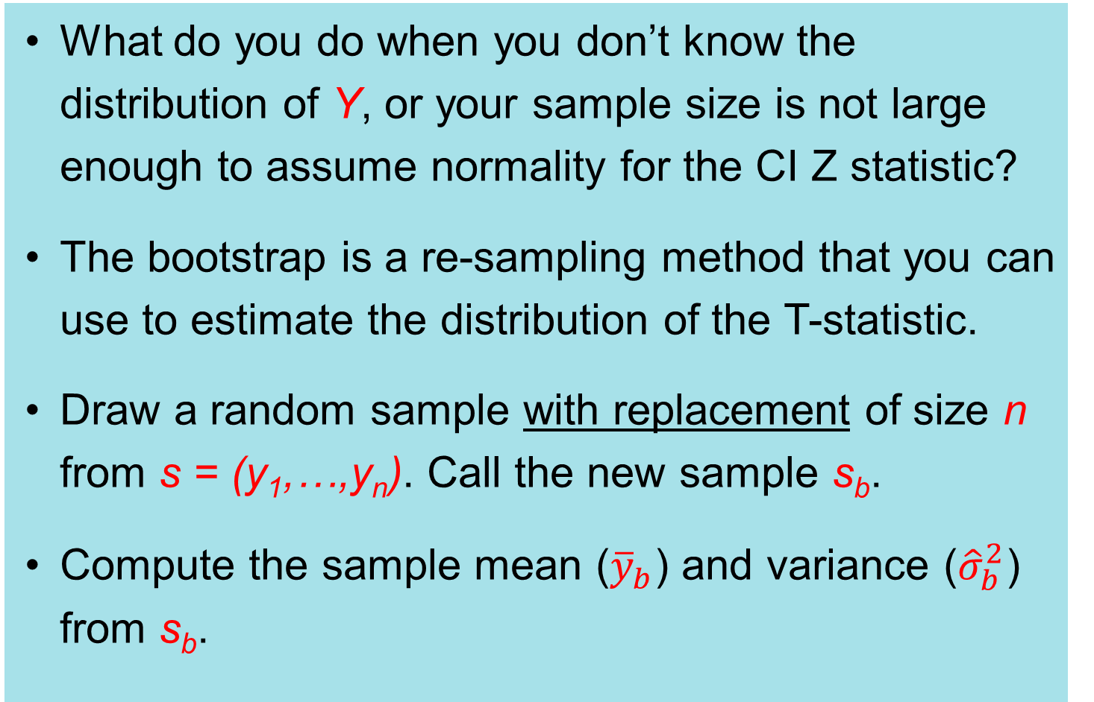
Bootstrap
What do you do when you don’t know the distribution of Y, or your sample size is not large enough to assume normality for the CI Z statistic?
The bootstrap is a re-sampling method that you can use to estimate the distribution of the T-statistic.
Draw a random sample with replacement of size n from s = (y₁,…,y_{n}). Call the new sample s_{b}.
Compute the sample mean (${\overline{y}}_{b}$) and variance (${\hat{σ}}_{b}^{2}$) from s_{b}.

Slide 149
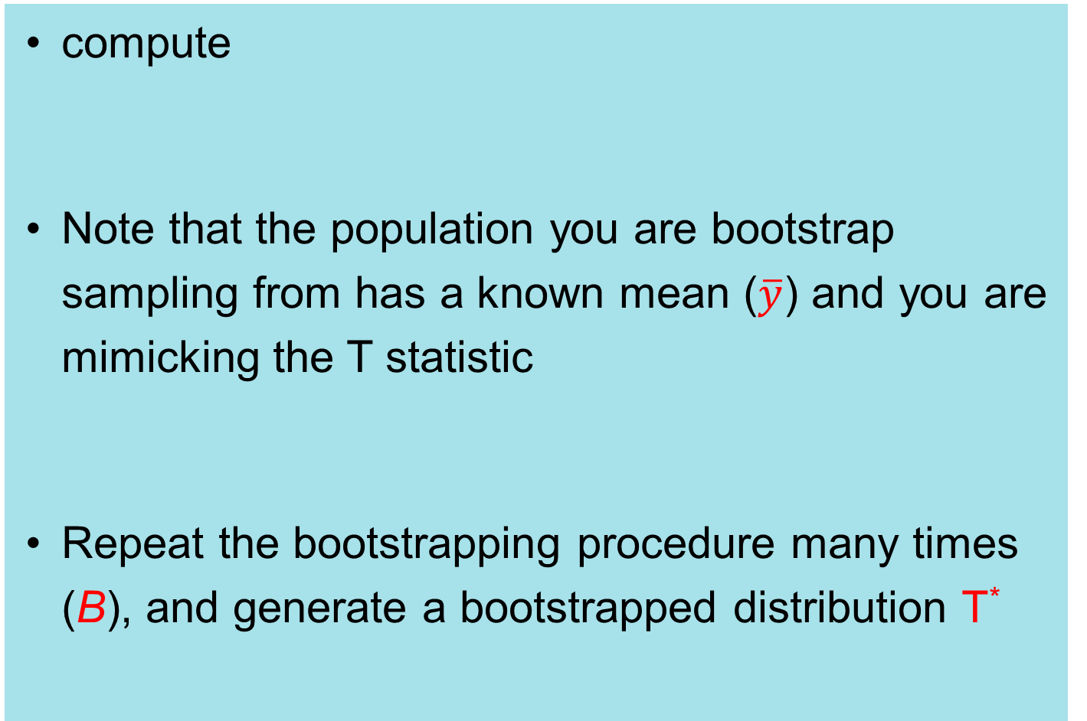
Bootstrap
compute
Note that the population you are bootstrap sampling from has a known mean ($\overline{y}$) and you are mimicking the T statistic
Repeat the bootstrapping procedure many times (B), and generate a bootstrapped distribution T*

Slide 150
Bootstrap
Bootstrap-t CI’s:
Approximate the T-statistic distribution using
If α=0.05 then this is the 0.975 quantile of T*
If α=0.05 then this is the 0.025 quantile of T*

Slide 151
One sample bootstrap in R
mu=10;
sigma2=1
n=10
y = rnorm(n,mu,sd=sqrt(sigma2))
ybar=mean(y)
s2 = var(y)
B=5000
booty = lapply(1:B, function(i) sample(y, replace = T))
boot.mean = sapply(booty,mean)
boot.var = sapply(booty,var)
boot.t = (boot.mean - ybar)/sqrt(boot.var/n)
quant.boot.t = quantile(boot.t,probs=c(0.025,0.975))
Store the quantiles of the bootstrapT distribution in quant.boot.t.

Slide 152
in R
hist(boot.t,breaks=50,xlim=c(-4,4),freq=F)
x=seq(-4,4,length=100)
pt = dt(x,n-1)
lines(x,pt,lwd=2,col='red',lty=1)

Slide 153
Bootstrap
What is the point, because we know the distribution of T anyway?
We can compute the bootstrap t-distribution of any statistic, as long as we know its std. err.
If fact, even if we don’t know the std. err, we can get an approximate CI directly from the bootstrapped distribution of the estimate

Slide 154
Bootstrapped mean in R
hist(boot.mean,breaks=50,freq=F)
x=seq(8,11,length=100)
pz = dnorm(x,mean=ybar,sd=sqrt(s2/n))
lines(x,pz,lwd=2,col='red',lty=1)

Slide 155
Bootstrapped geometric mean in R
install.packages("psych")
library("psych")
boot.geomean = sapply(booty,geometric.mean)
hist(boot.geomean,breaks=30,freq=F)

Slide 156
Bootstrapped geometric mean in R
sd=0.190
sd=0.189

Slide 157
Bootstrap
There are other versions of the bootstrap that are designed for the regression situation
and there are several ways of getting bootstrap CI’s once you decide how to resample your data
But that’s enough for now. I will introduce some of the other methods later in the course

Slide 158
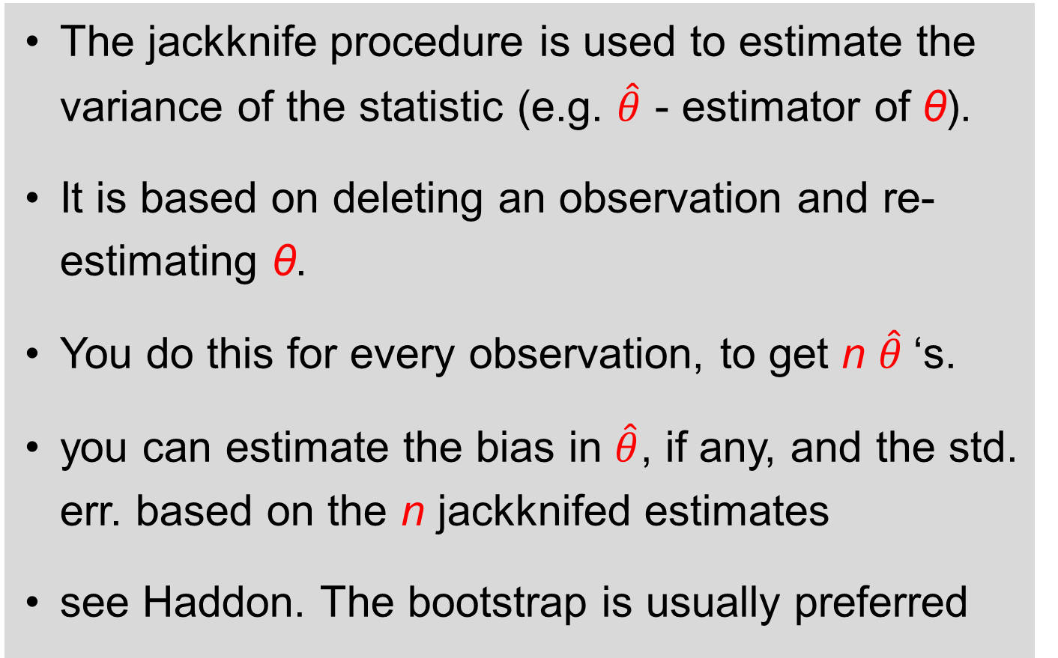
Jackknife
The jackknife procedure is used to estimate the variance of the statistic (e.g. $\hat{θ}$ - estimator of θ).
It is based on deleting an observation and re-estimating θ.
You do this for every observation, to get n $\hat{θ}$‘s.
you can estimate the bias in $\hat{θ}$, if any, and the std. err. based on the n jackknifed estimates
see Haddon. The bootstrap is usually preferred

